Slide 1
[Statistics] For R & Python
[Pavan Gudipati]

Slide 2
Statistics is a branch of mathematics dealing with the
collection,
organization,
analysis,
interpretation, and
presentation of data

Slide 3
Population – Complete data
Sample – subset of Population
Population:
Good and correct output
Impractical or impossible or very expensive
Sample
Simple, less expensive
Close to Population

Slide 4
sample
Should be
Unbiased
Representative
Random
Judgement based ( Non-random)
Advantages: Cost, Accuracy, timelines

Slide 5
Variable
Type of data
1) Dependent -> outcome
Independent -> input value
Dependent = Exam Marks
Independent = No of hours studied
Qualitative and Quantitative Variables

Slide 6
Variable
Experimental
Non-experimental ( nuclear, unethical drug design)
Categorical / Continuous
Categorical: Discrete, Qualitative, Types
Continuous: ratios, fractional, range E: Temperature
Discrete: Counting, integer
Methods: Cluster, stratified, Random

Slide 7
Percentiles
Values below x %
Eg: 75%
25,50,75,100 %
85%, below you 85% students out of population.

Slide 8
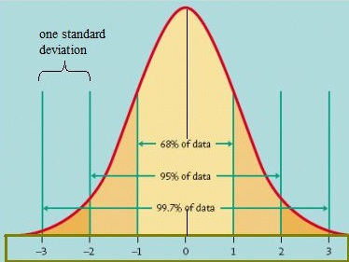
Normal Distribution , 1 sigma

Slide 9
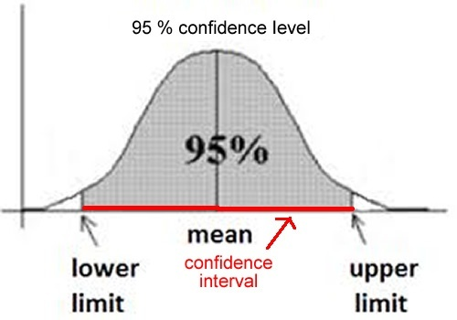
Confidence Interval

Slide 10

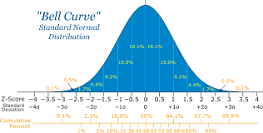
Eg: Marks in Examination for all students in a class
1 sigma = 68.3%
2 sigma= 95.4 %
3 sigma = 99.7

Slide 11
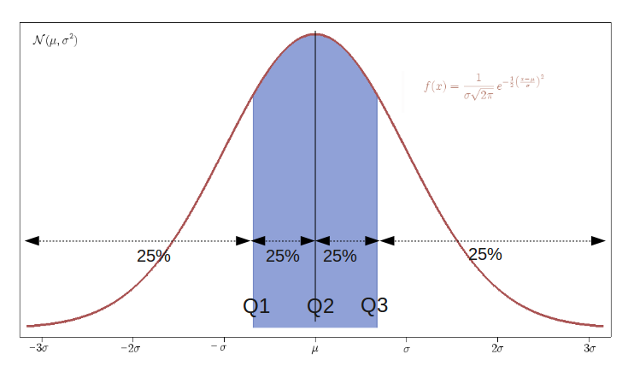
P 25 (25% Percentile ) Lower Quantile
P 50 – Median
P75 = Above quantile

Slide 12
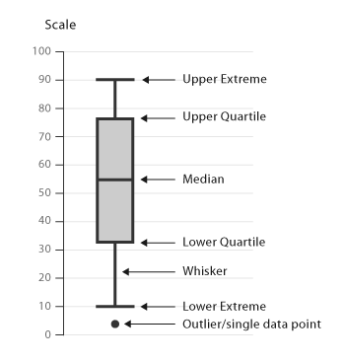
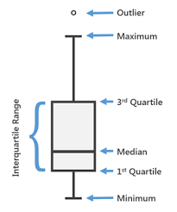
Boxplot - quantile

Slide 13
Central Limit theorem
Mean = Avearge
Median = Middle Number in a Sequence
Mode = Most Frequent

Slide 14
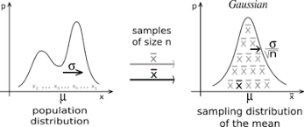

Slide 15
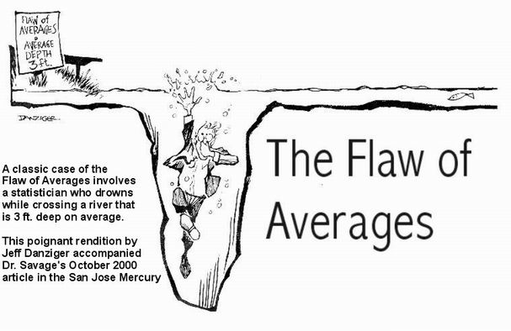

Slide 16
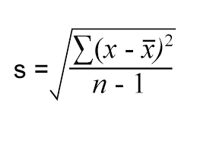
Standard Deviation & Variance
Amount of Variation from mean
Low SD = Close to Mean
High SD = Spread Across
SD can be Negative/Positive. Variance only Positive.
Variance (S) = SD ^ 2

Slide 17
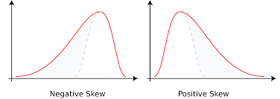
Skewness

Slide 18
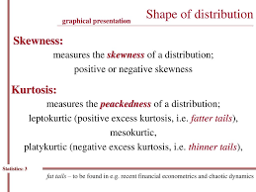

Slide 19
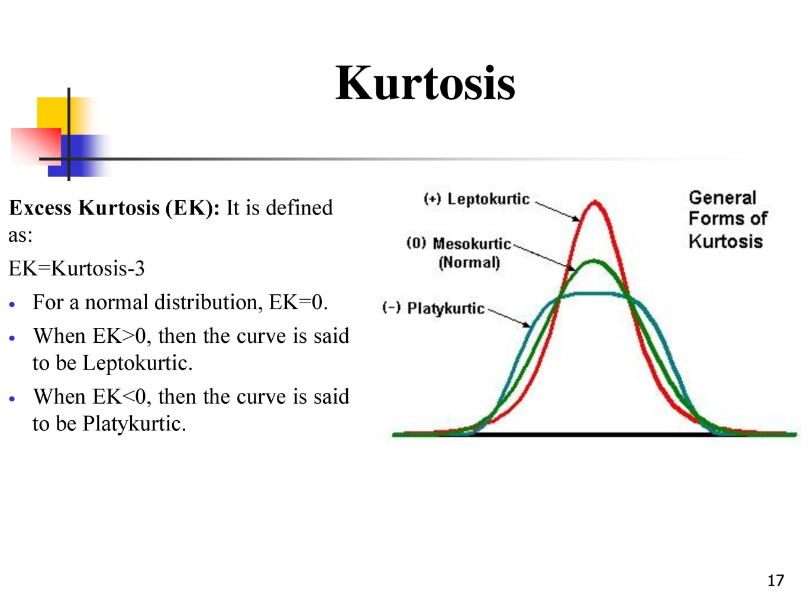
Kurtosis - Peak

Slide 20
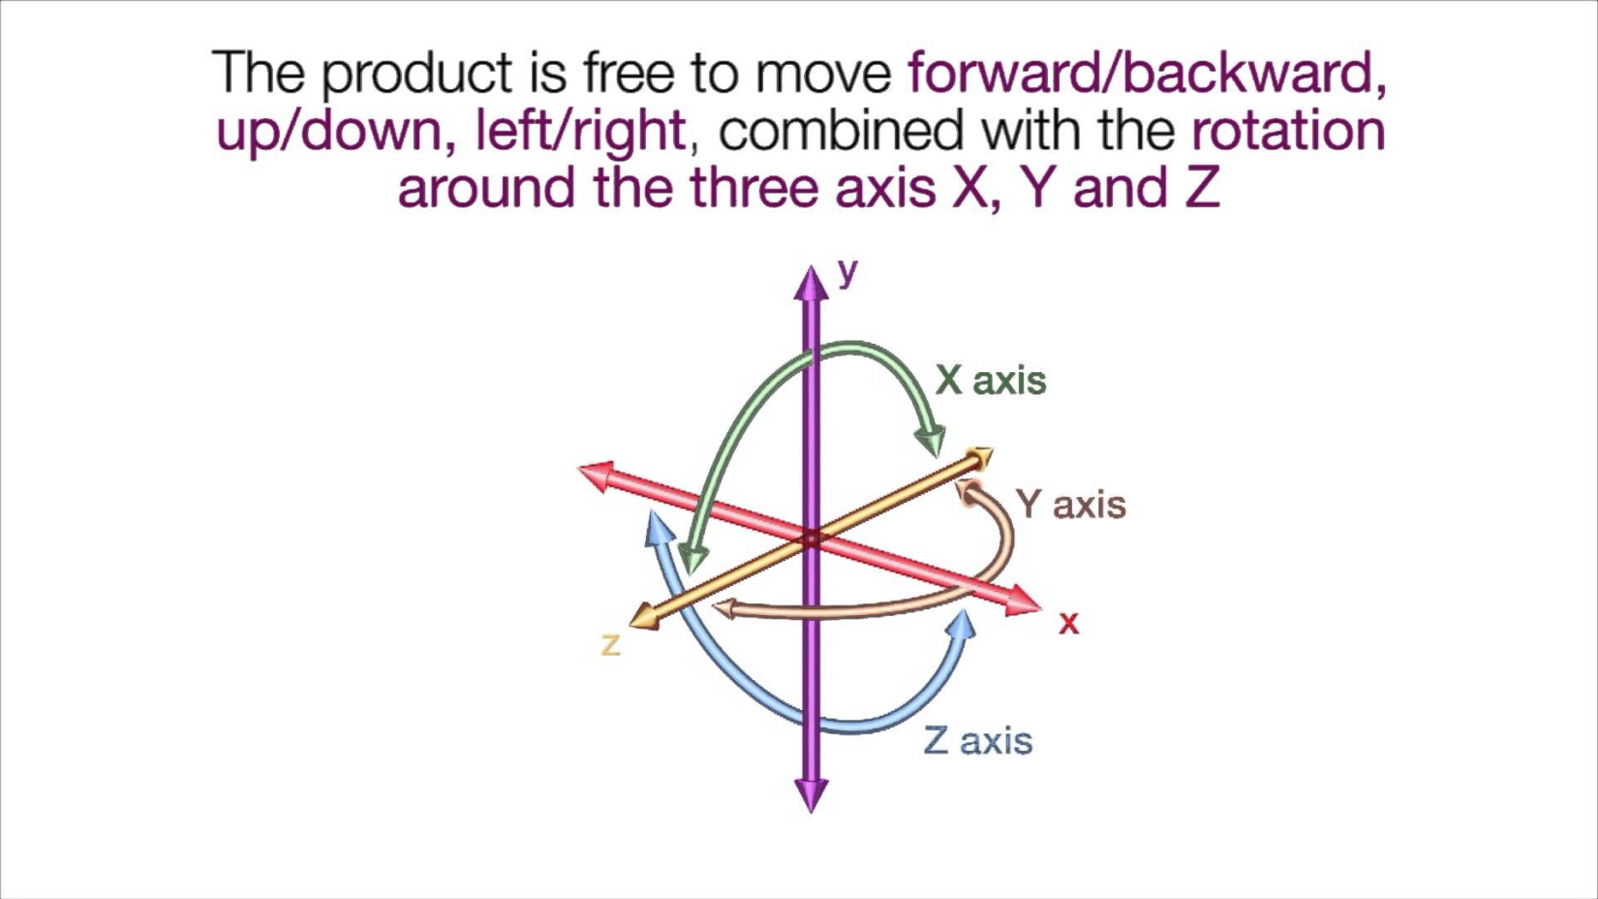
Degree of Freedom ( DF ) / nu

Slide 21
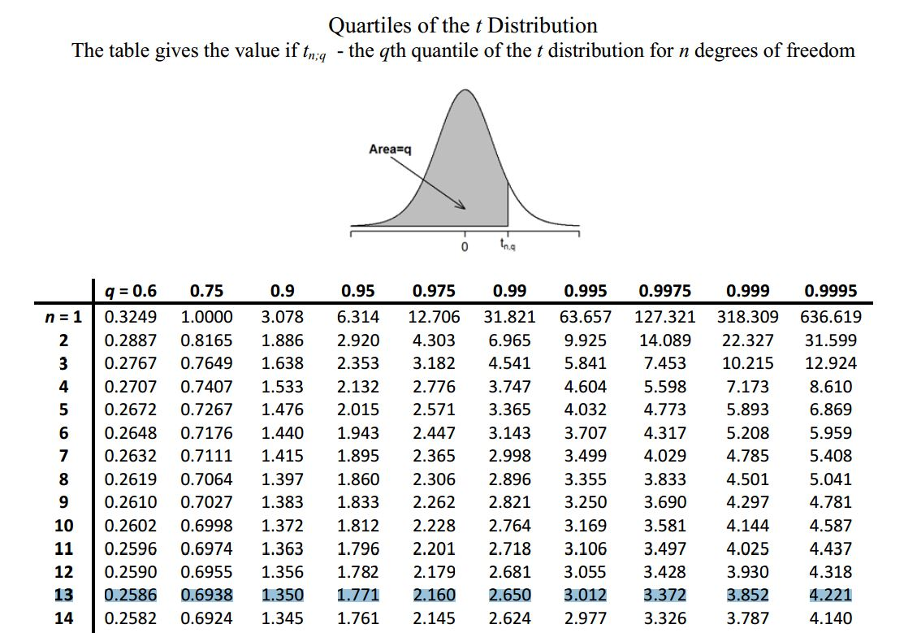

Slide 22
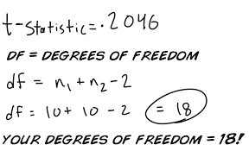
Df = n-1
In equations, the typical symbol for degrees of freedom is ν (lowercase Greek letter nu). In text and tables, the abbreviation "d.f." is commonly used. R. A. Fisher used n to symbolize degrees of freedom but modern usage typically reserves n for sample size.

Slide 23
Student's t-distribution / t-test
Although the basic concept of degrees of freedom was recognized as early as 1821 in the work of astronomer and mathematician Carl Friedrich Gauss,^{[3]} its modern definition and usage was first elaborated by English statistician William Sealy Gosset in his 1908 Biometrica article "The Probable Error of a Mean", published under the pen name "Student".^{[4]} While Gosset did not actually use the term 'degrees of freedom', he explained the concept in the course of developing what became known as Student's t-distribution. The term itself was popularized by English statistician and biologist Ronald Fisher, beginning with his 1922 work on chi squares.

Slide 24
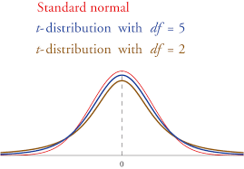
Student's t-distribution

Slide 25
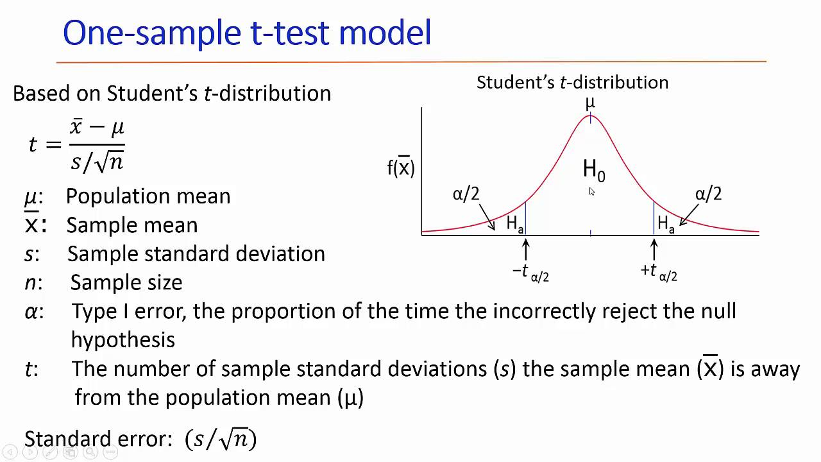

Slide 26
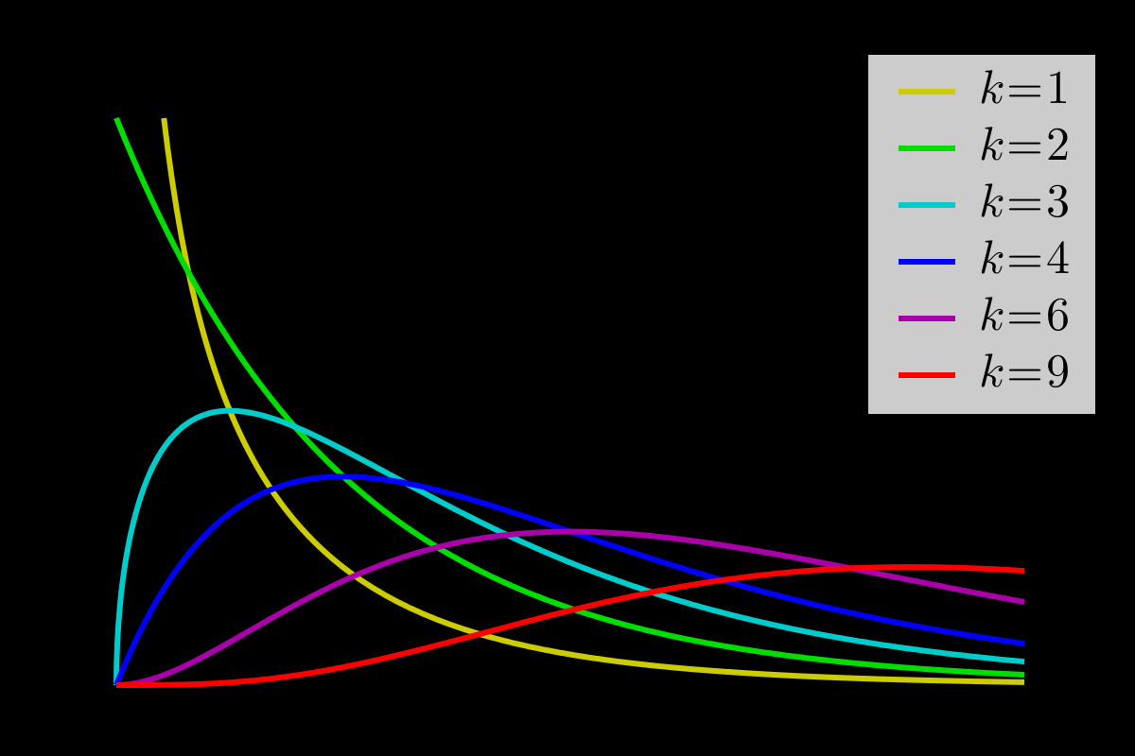
Chi square

Slide 27
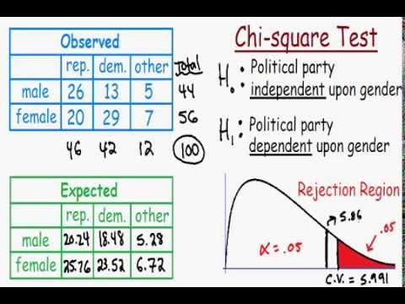

Slide 28
Chi square
Test of Indepedence
is 2 category variables are dependent ??
Cat A / Cat B

Slide 29
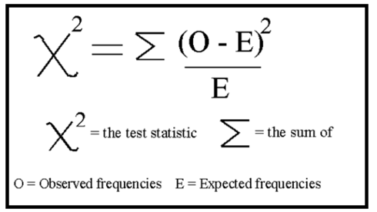

Slide 30
Significance : 0.05 <

Slide 31
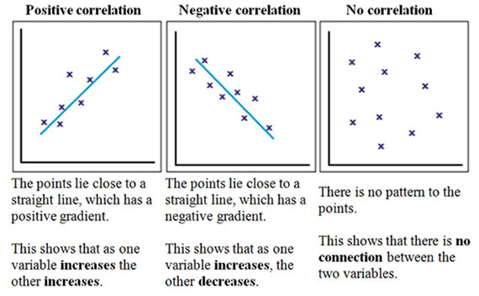
Correlation , rho

Slide 32
Correlation
Direction : Positive/ Negative
Strength : Low , Medium, high
Between -1 to 0 to +1

Slide 33
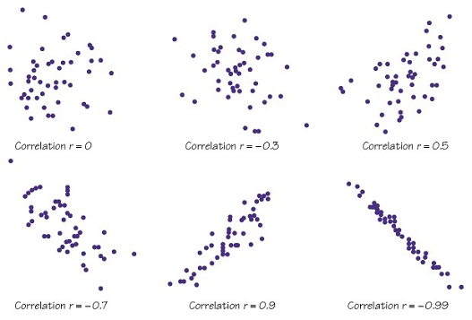
Scatter plot / reg plot

Slide 34
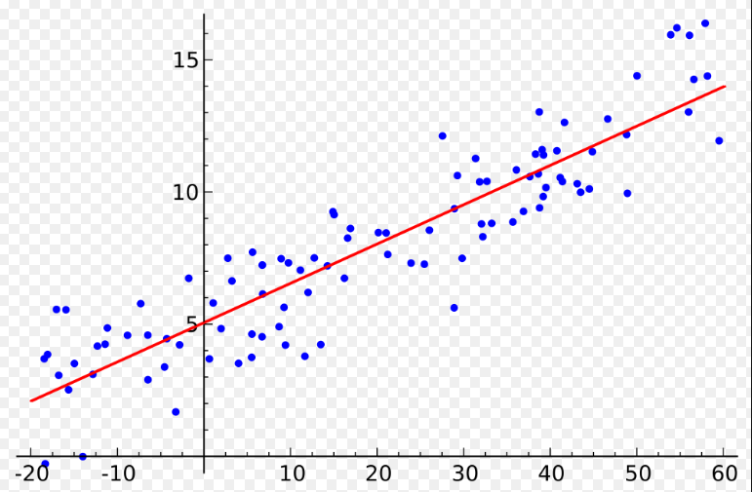
Regression Plot & Equation

Slide 35
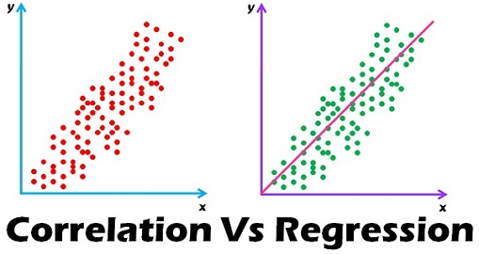

Slide 36
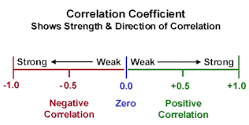
Corr Coefficient

Slide 37
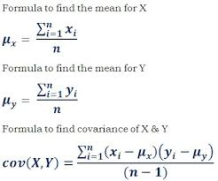
Cov(x,y)

Slide 38
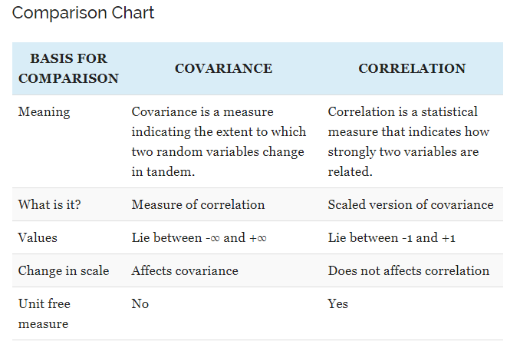

Slide 39
Distribution
Normal
Binomial
Poisson
Bernouli

Slide 40
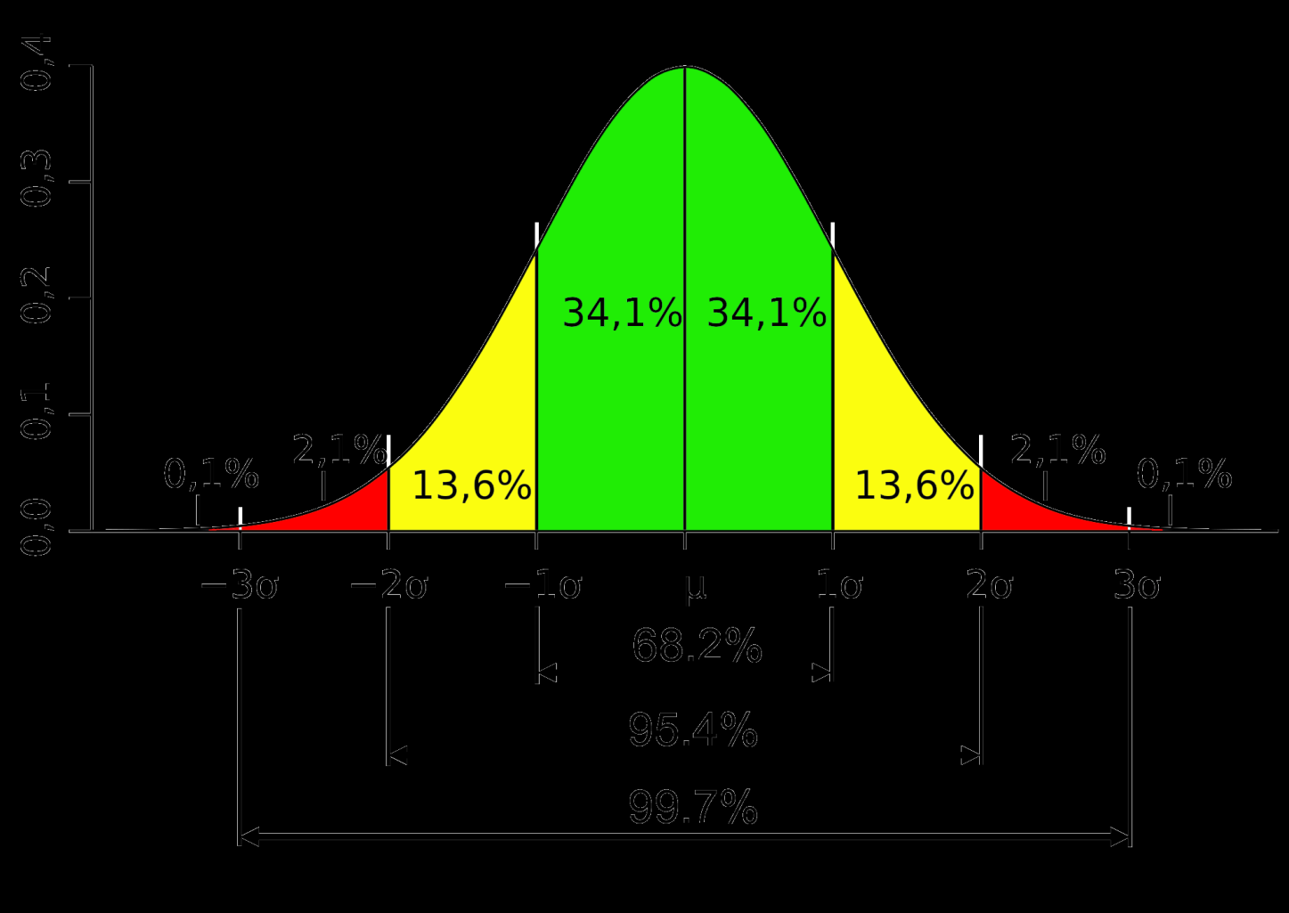

Slide 41
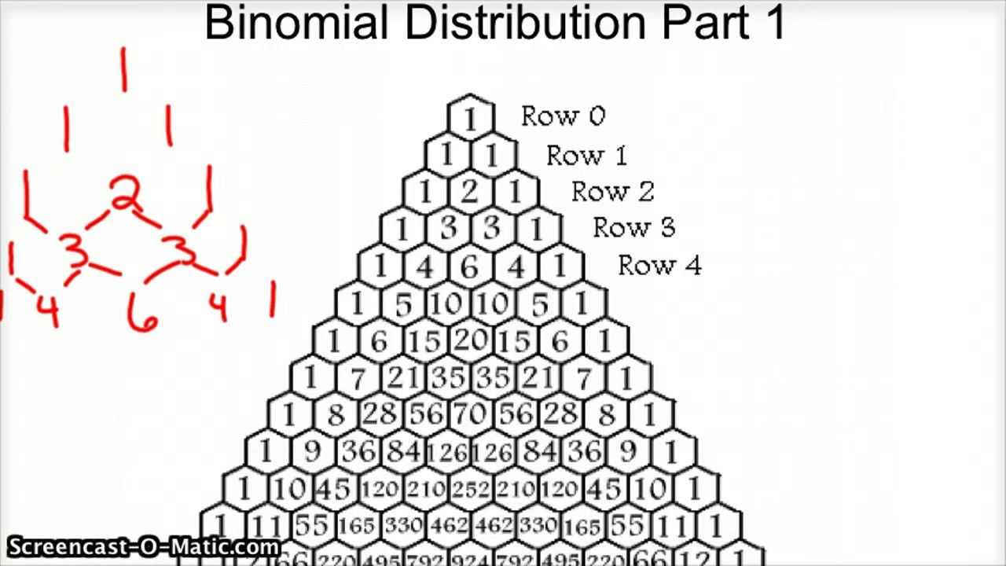
Binomial

Slide 42
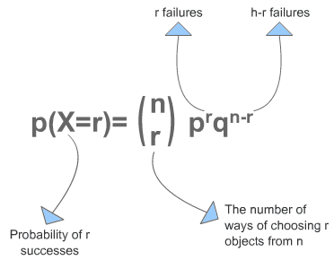

Slide 43
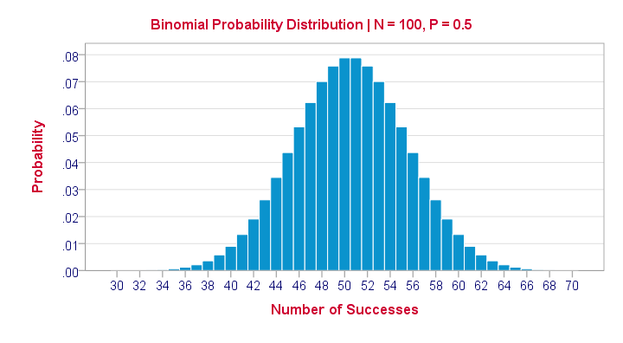

Slide 44
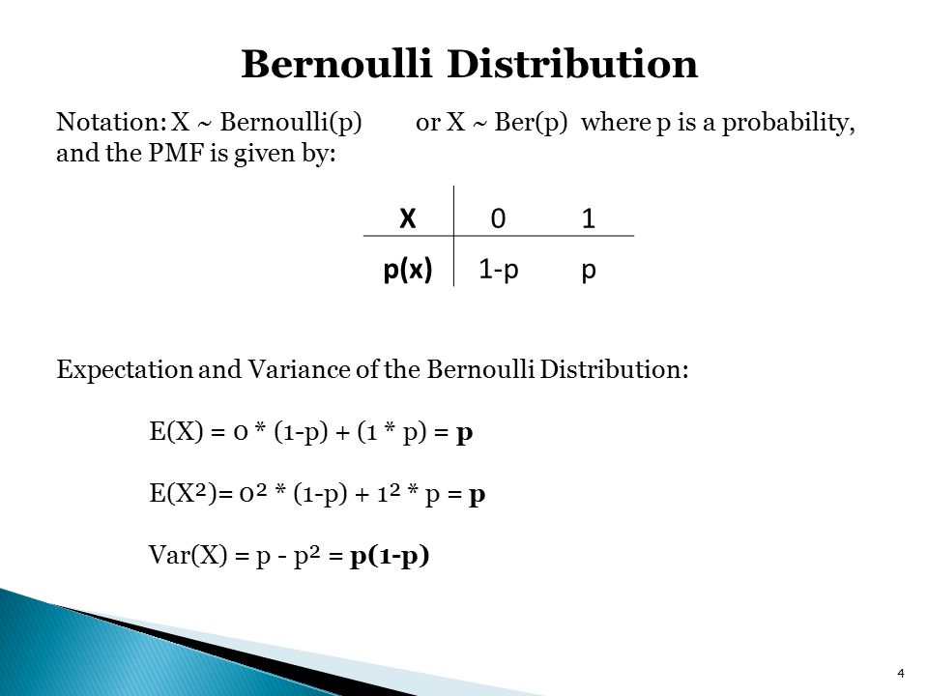
Bernouli

Slide 45
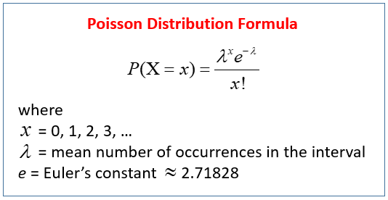
Poisson

Slide 46
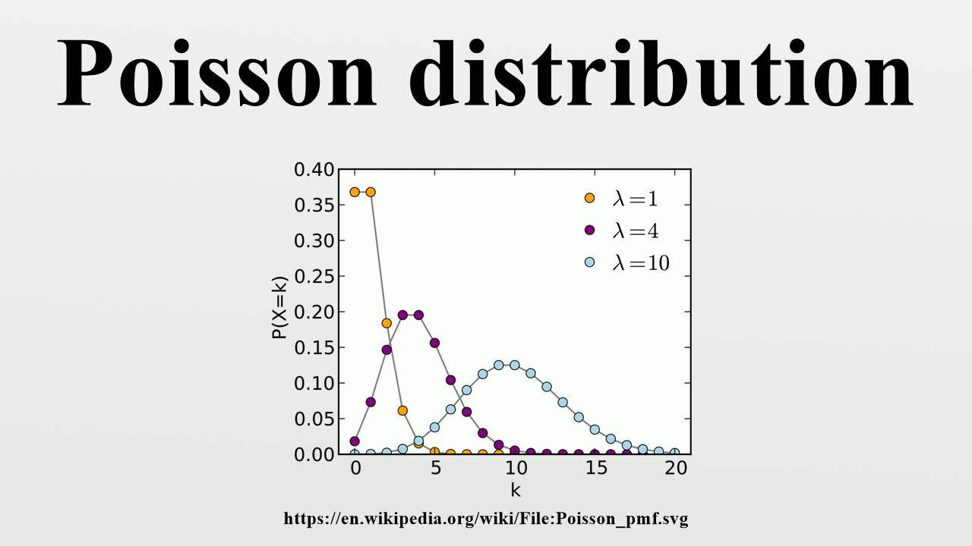

Slide 47
Poission
Number of events
Eg: 4 emails per day
Each email is independent
Lambda - expected number of occurrences
Bernouli : A single success / failure of trial

Slide 48
Decision Making Rules
Test of Hypothesis
Null H = H-O
Alternative H H-1 or H alpha
Null Hypothesis:
No difference in the data
No relationship
Significance levels
Sample size

Slide 49
P – value <0.05
Measure of strength

Slide 50
Errors
Type I:
Risk of Rejecting Null Hypothesis , when it is in fact TRUE.
Eg: Risk of Rejecting Valid credit card
Type II
Risk of NOT rejecting when it is FALSE
Eg: Risk of NOT Rejecting, when Fraud Credit card.

Slide 51
Parametric Test
Non – Parametric test
Need more info?

Slide 52
Exploratory data analysis
Frequency
Histogram
Boxplot
Scatter plot
Error Bar etc
Descriptive statistics: mean,mode,median

Slide 53
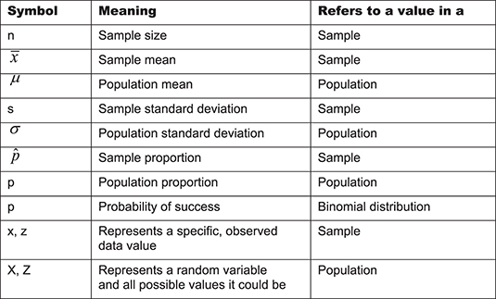

Slide 54
DATA to information
Information to Facts
Fact to Knowledge

Slide 55
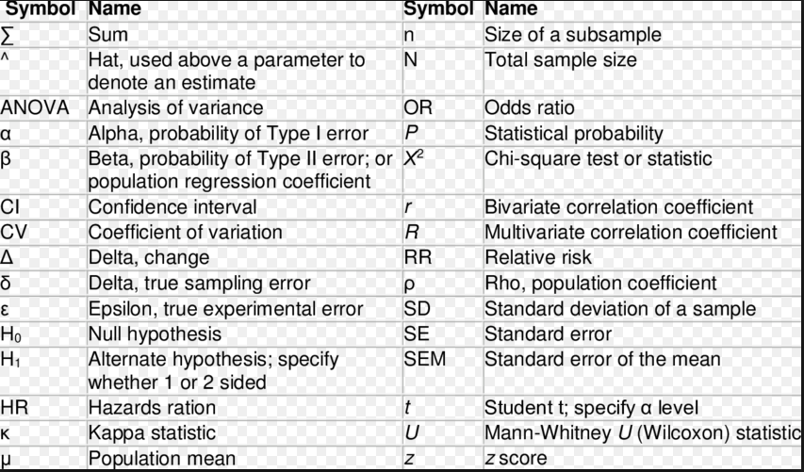

Slide 56
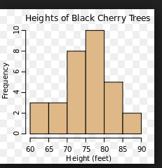
Histogram / Frequency

Slide 57
MSE : Mean Square Error

Slide 58
Histogram : Histogram, Q-Q Plot ( quantile)
Significance test
Density Plot
Ho = Normal
if test is significant then Non- Normal at p < 0.05

Slide 59
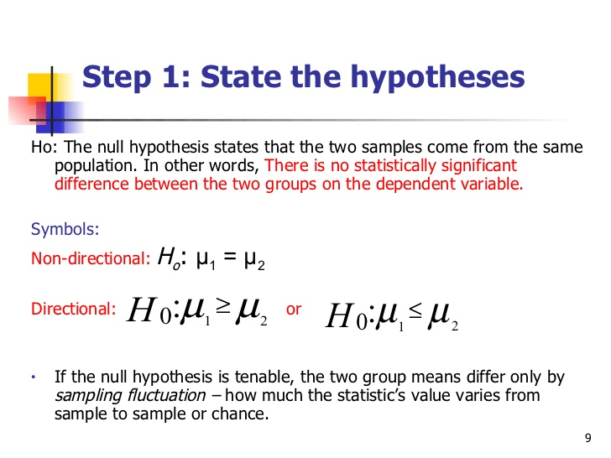
One sample test
Two sample test - more?

Slide 60
ANOVA
Analysis of Variance
One Way
Two way
Eg: which therapy is good?
Which manufacture method is good?

Slide 61
One / two : No of independent variables
One Way: One brand of Cereal – levels A,B,C
Two Way: Cereal and Calories – levels, X, Y
MANOVA – Multiple
F- Value for Confirmation

Slide 62
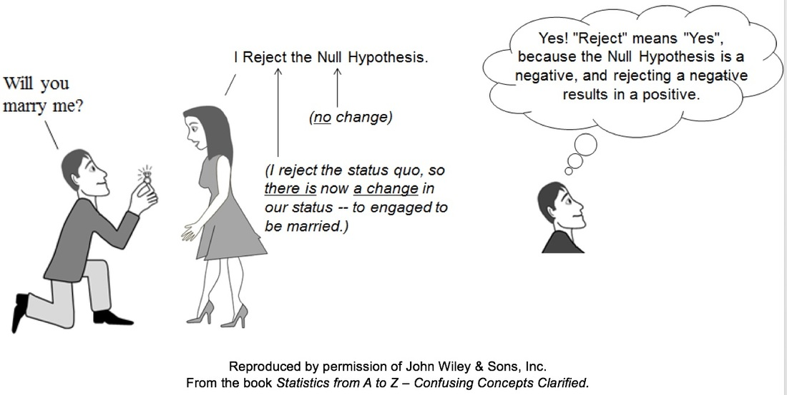

Slide 63
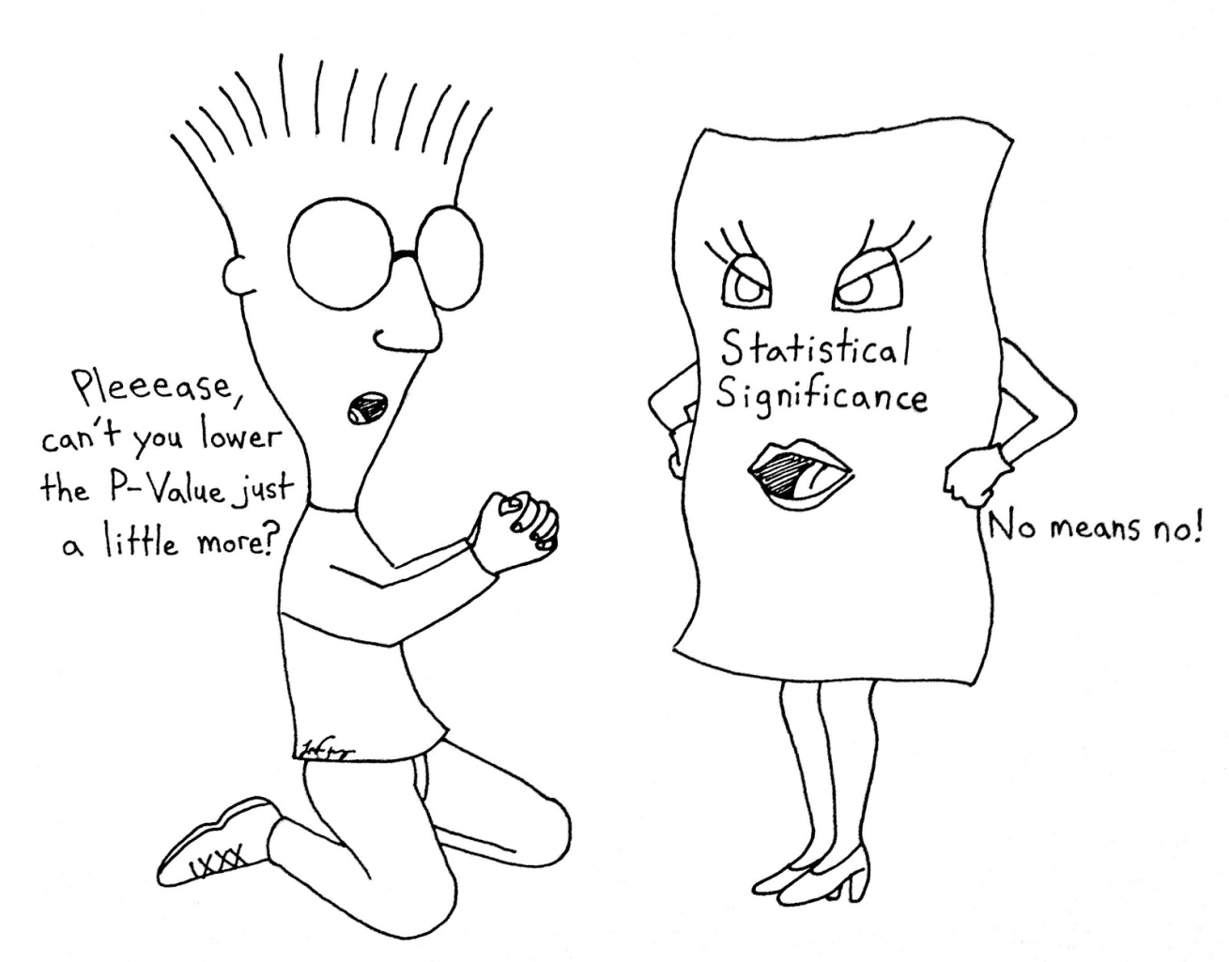

Slide 64
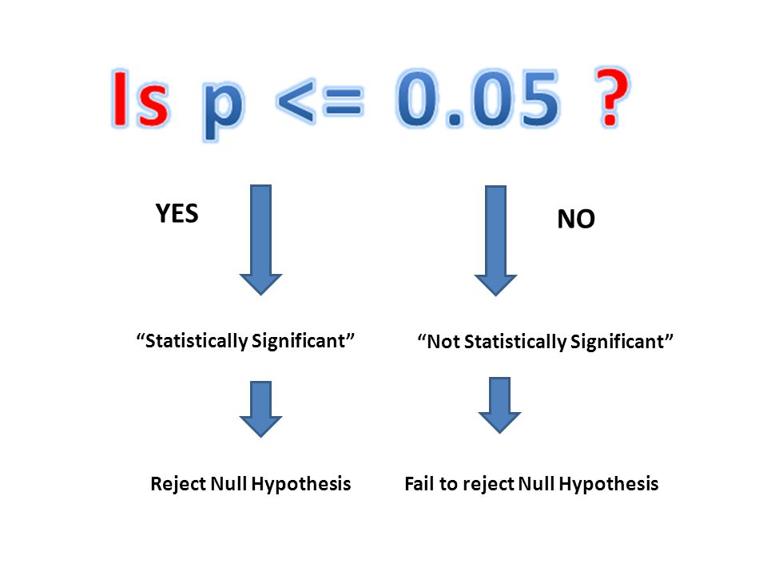

Slide 65
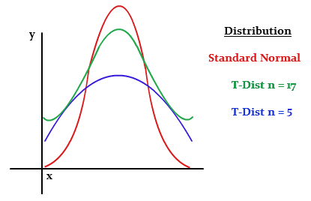
t distribution ( n= 30 )

Slide 66
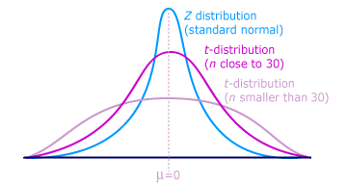

Slide 67
Prediction Analytics
Linear Regression
Simple
Multiple
Dependent Vs. Independent Variables
Prediction
Forecast

Slide 68
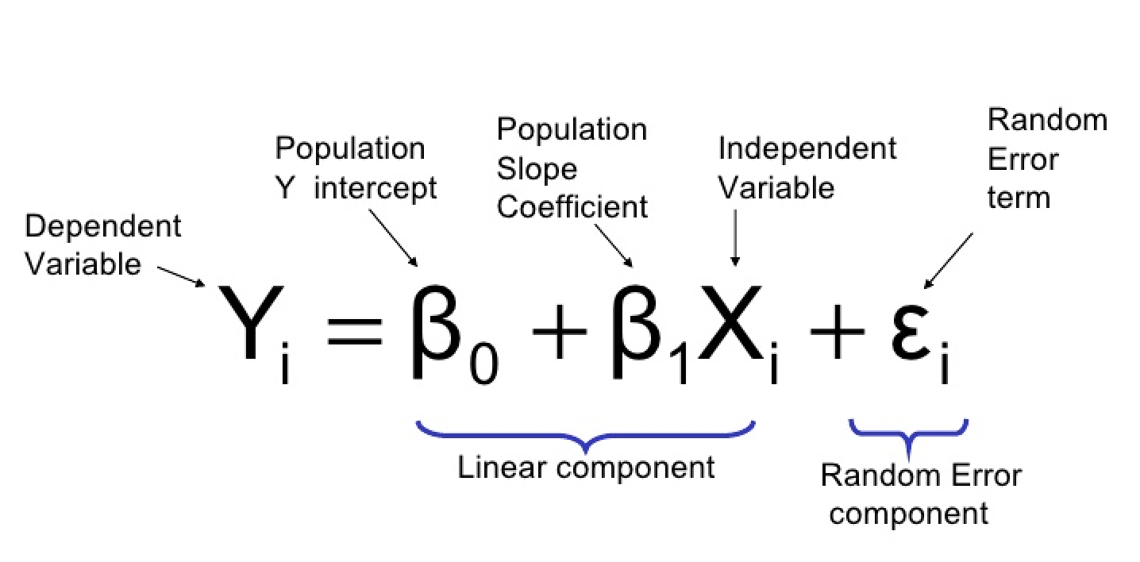
Logistic Regression For category Prediction

Slide 69
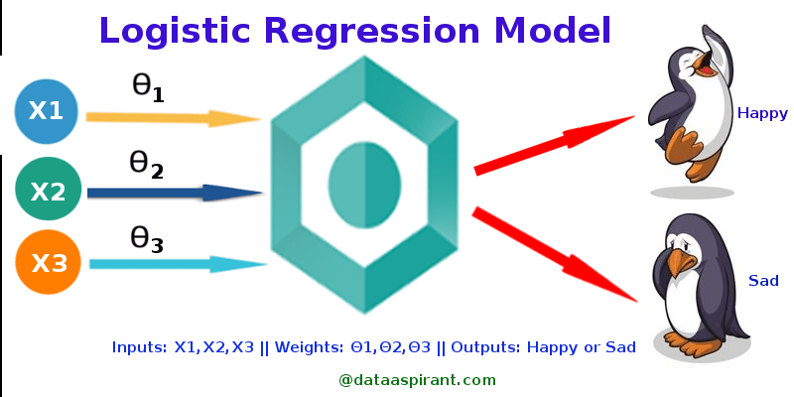

Slide 70
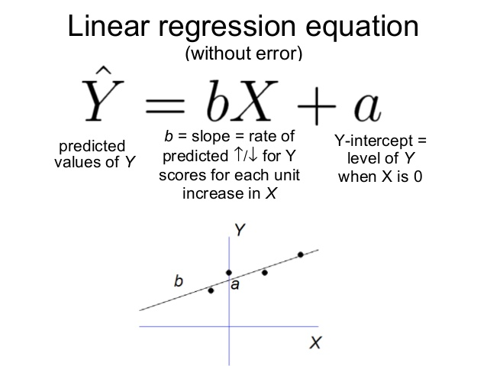

Slide 71
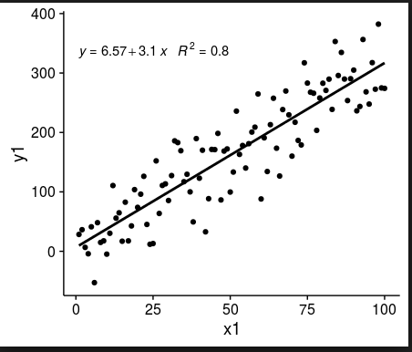
Regression

Slide 72
Quality of Regression
R - Residual
R Squared : How close the data are fitted reg line. > 0.7 is good
R adjusted
R Sum square
Least Square ( x- X mean)
R = regression coefficient

Slide 73
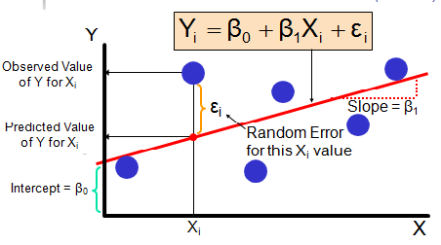
Regression

Slide 74
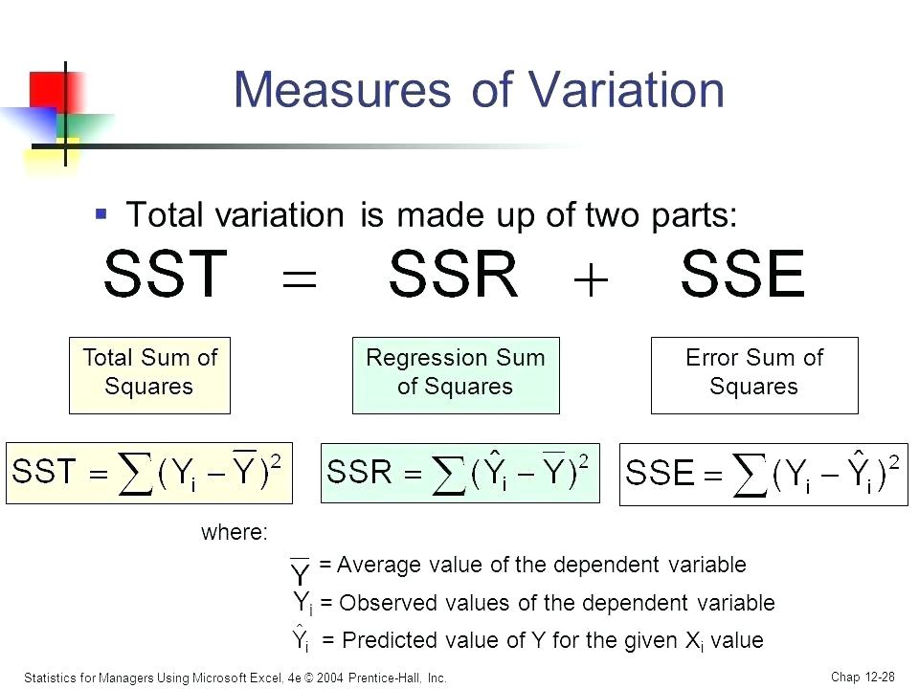

Slide 75
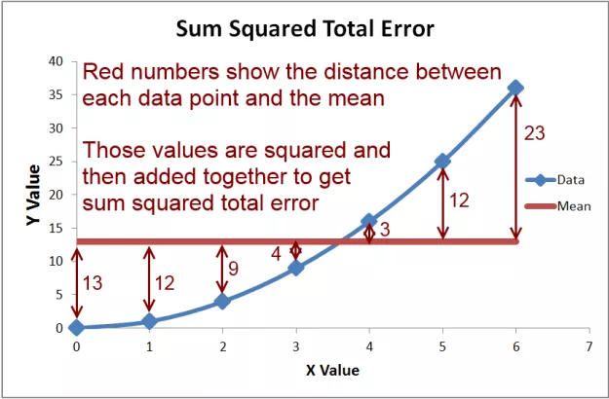

Slide 76

Root mean squared Error

Slide 77


Slide 78

Multi colinearity
High corr among independent variable, if present, data may not be reliable.

Slide 79
Dummy Variable
Indicator variable
Either 0 / 1 absence / presence
In Time series analysis
In Forecast
In credit scoring
Gender , Years of Education
K = number of levels

Slide 80
Transformation of Data
value into Log Value
Logarthmic
Squareroot
Reciprocal

Slide 81


Slide 82

Logistic Regression

Slide 83
Logistic Regression
Yes / No category
LOGIT

Slide 84


